Slide 1
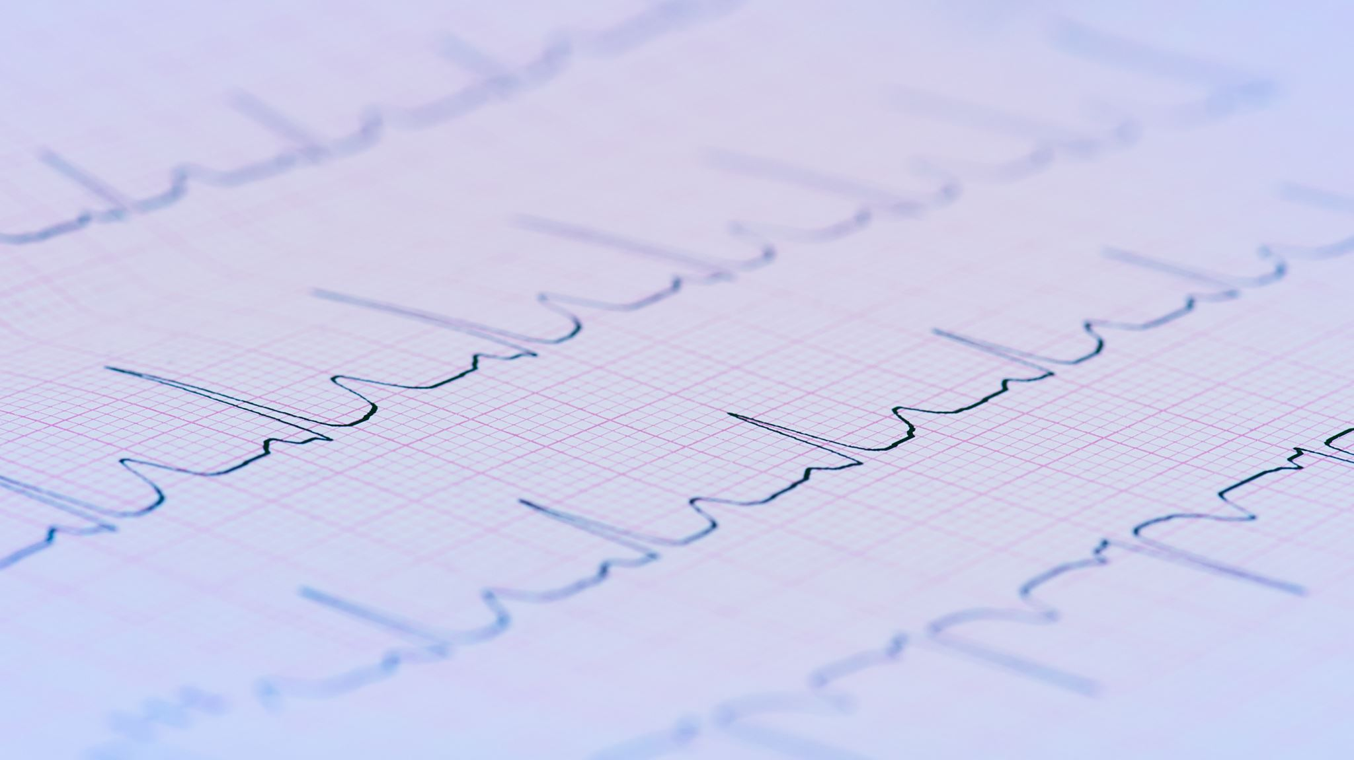
Frequency And Sound Recognition on the Micro:bit V2
Joshua Hill

Slide 2
Pipeline
…
…
…
Level Detector
Tap Recogniser
Microphone
Normaliser
Splitter
Frequency Detector
Morse Code
Mic Recorder
…
…
…

Slide 3
Frequency Detection Base Design
Core Audio Processor Functionality – Recognise up to
Two frequencies and their closest Note Letter
Splitter
Frequency Detector
Frequency in Hz
Closest Note
On Note Heard

Slide 4
Frequency Detection Base Implemented
Core Audio Processor Functionality – Recognise up to
Two frequencies and their closest Note Letter
CPP / MakeCode Adaptation
Get Closest Primary note
Get Primary Frequency
Get Closest Secondary Note
Get Secondary Frequency
On Hearing (Note)
Start
Stop
Char / Int
Int
Splitter
Frequency Detector
Char / Int
Int
Event e
Void
Void

Slide 5
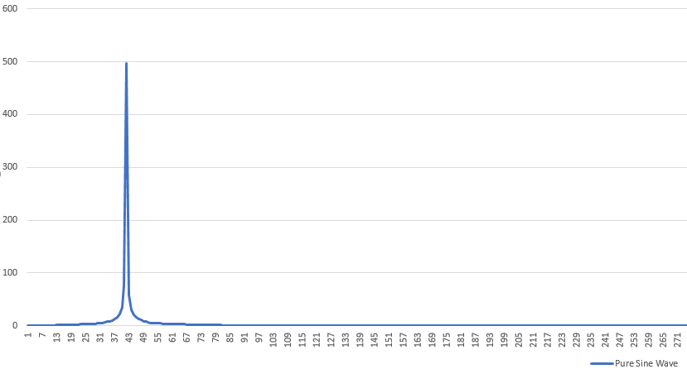
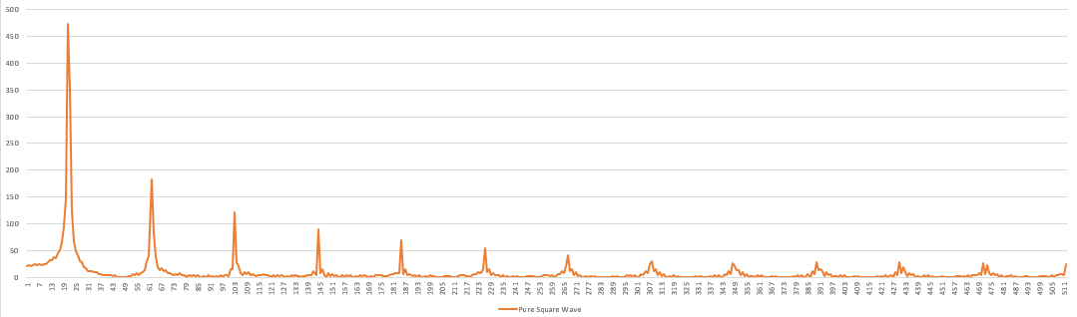
Sine vs Square
Sine waves are easier to detect – they produce a peak at the relevant bin and frequency is simply bin resolution * bin number with highest magnitude.
Square waves are more complex, the base frequency is actually the distance between the harmonic spikes on the graph

Slide 6
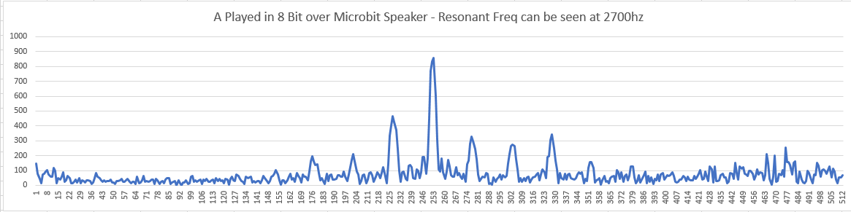
What does a Micro:bit Wave look like?
Spikes not always evenly distanced, not in correct order of magnitude
Spike at resonant frequency of speaker which is ~2700hz

Slide 7
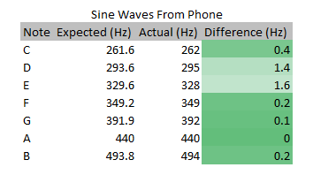
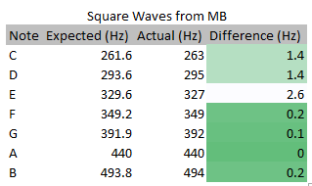
Recognition Accuracy
Results across the board are within 2.6hz of the target frequency, with average difference of just 0.7hz

Slide 8
FFT Statistics
2048 size FFT
Bin resolution of 11,025/2048 = 5.38hz
Runs on a 128 byte (sample) sliding window, doing 2 FFT runs per input buffer from the mic (256 samples)
Takes ~10-11ms to run at most (if square wave detection is required)

Slide 9
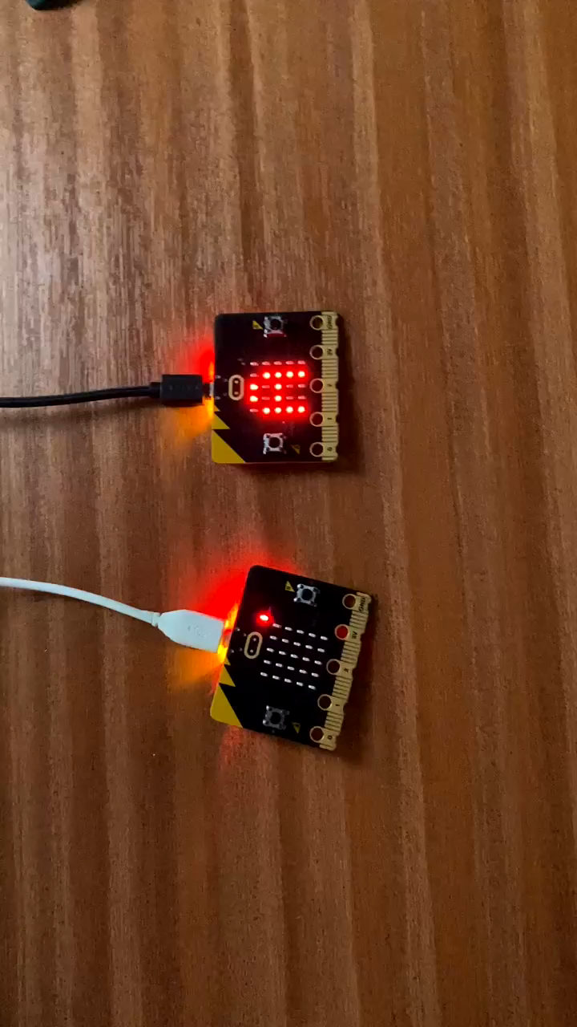
Event Based Detection – showing closest primary note

Slide 10
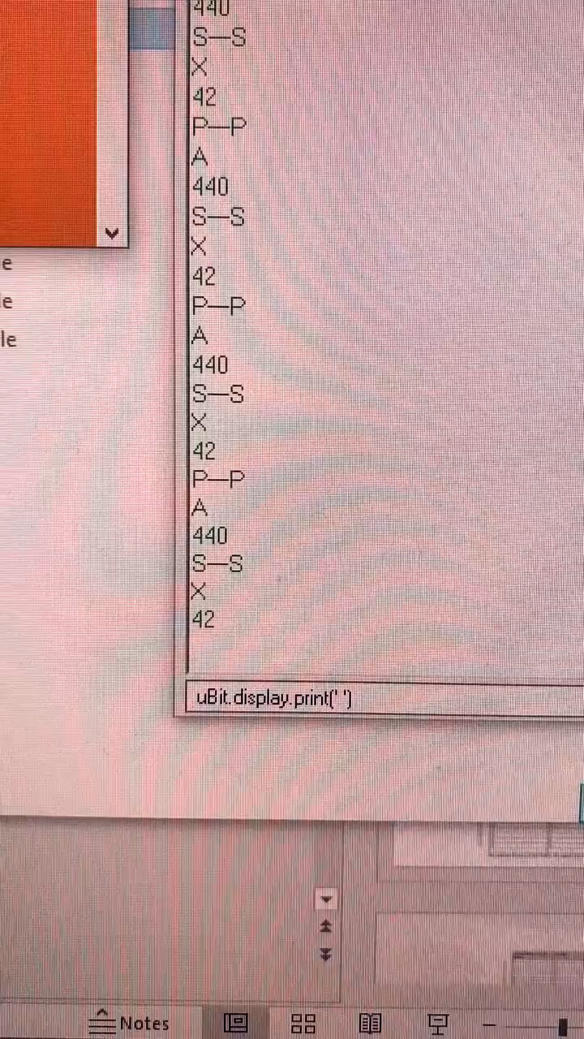
Primary and Secondary Frequency Test
Format:
P—P
Primary Note
Primary Frequency
S—S
Secondary Note
Secondary Frequency

Slide 11
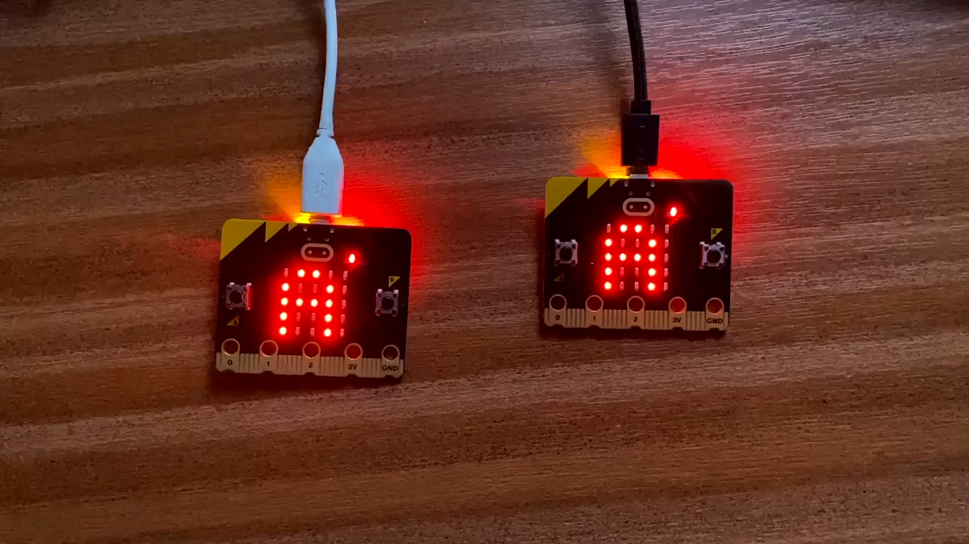
Primary and Secondary Frequency Visual Test Left primary, Right secondary

Slide 12
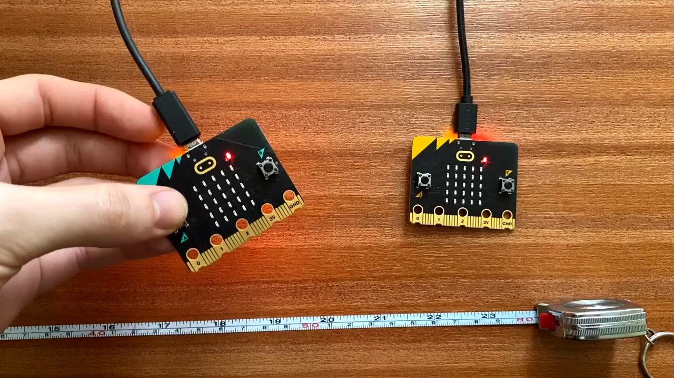
HTTP request/response – showing distance effect on signal strength

Slide 13
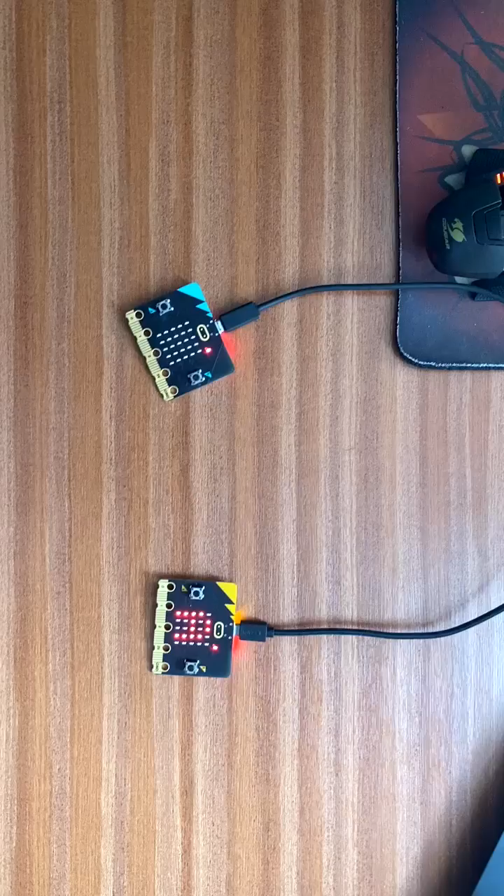
How noise (literally!) disrupts signals

Slide 14
Morse Code
Capable of converting strings into Morse dots and dashes
Can play and detect in two frequencies simultaneously (primary and secondary)
Optimized for 30cm distance
CPP / MakeCode Adaptation
Void
Play Char
Play String
Serial Print Stored
Get Last Char
Get Stored Message
Clear Stored Message
Start
Stop
Void
Audio Processor
Morse Code
Void
Char / Int
String
Void
Void
Void

Slide 15
Morse Features
No sync needed – attempts to do it on the fly by adjusting its run time between each sample slightly (primary freq only).
Number correct needed configured when Micro:bits are 30cm apart.

Slide 16
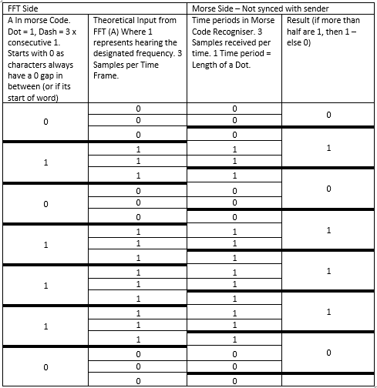
We actually have 22-23 samples per frame for a 250ms dot length, and 44 for a 500ms dot length.
Real threshold based on testing from 30cm away – less than half to account for the off failed recognition

Slide 17
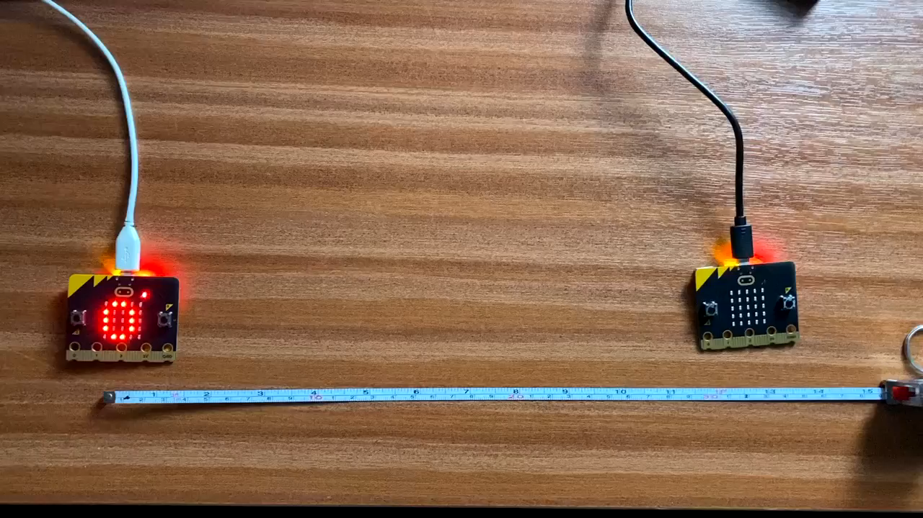
500ms Morse Test 30cm
Starting 0 means – nothing recieved

Slide 18
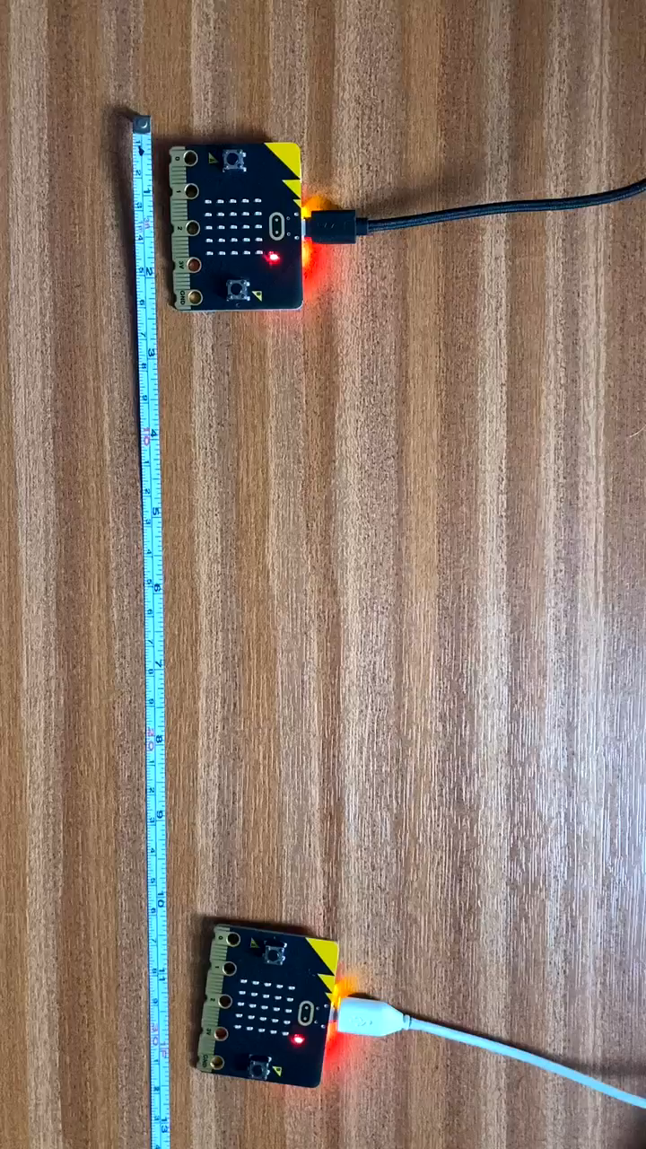
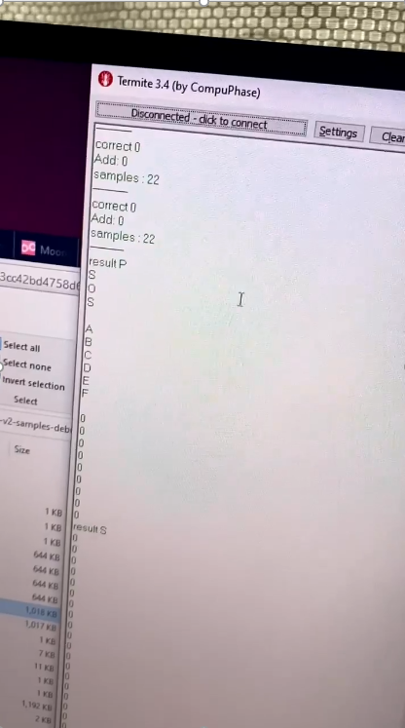
250ms Morse Test 30cm

Slide 19
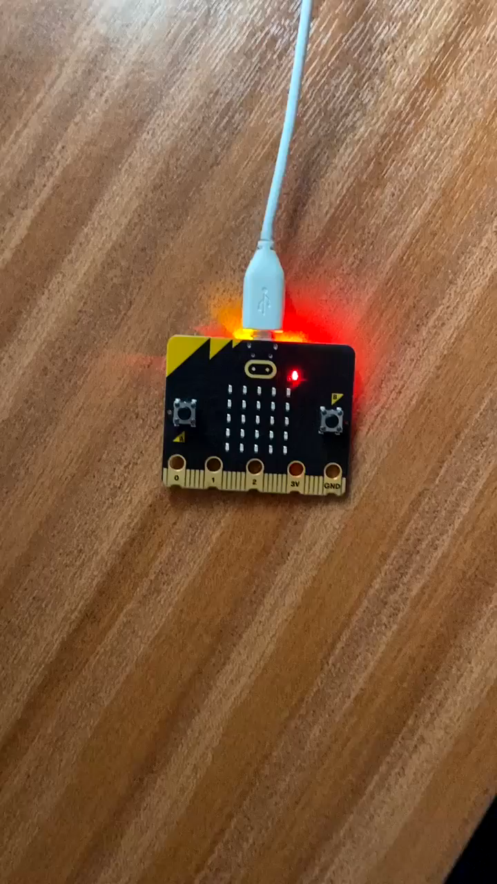
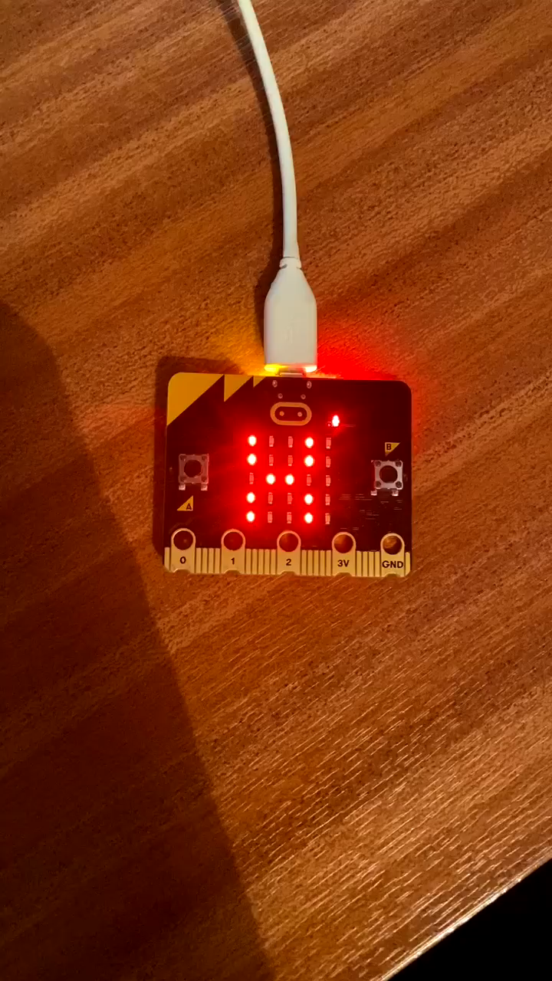
Voice Morse Test
A
B and C

Slide 20
Tap Detector
Intro to ML + Pattern Detection
Record and store Patterns (up to 10), each bin accounts for 500ms
Test live input for matches to stored patterns
CPP / MakeCode Adaptation
Audio Processor
Tap Detector
Record Pattern
Redo Pattern
On Pattern Recognised
Void
Void
Event e

Slide 21
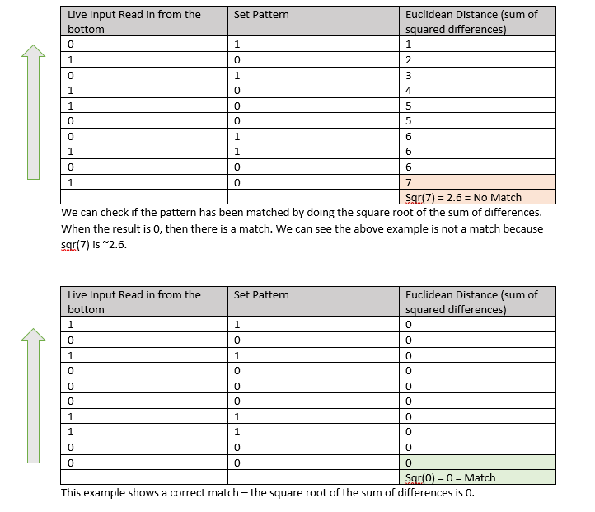

Slide 22
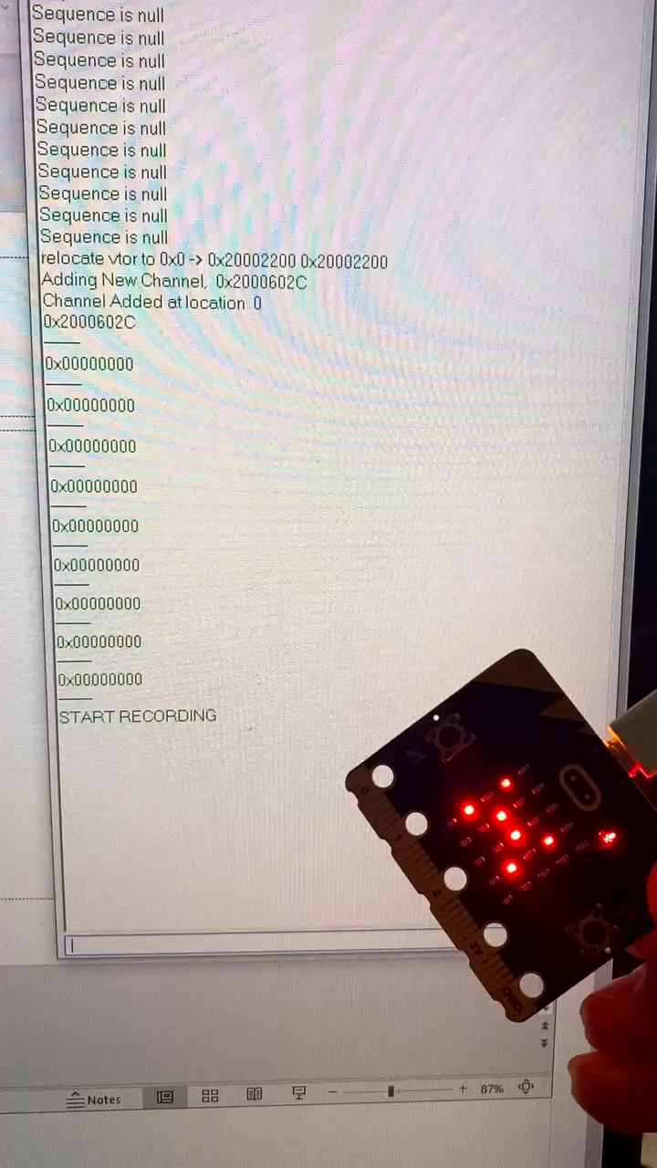
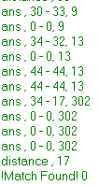
Tap recogniser test
Pattern recorded by pressing A
Print out format
Ans | Live input | Stored Pattern | Euclidean distance
Final Euclidean distance shown at bottom of each segment
Buffers should be read bottom to top i.e. most recent value last
Pattern hummed in binary is:
Non-exact match found
1 | 33
0 | 0
1 | 32
0 | 0
1 | 44
1 | 44
1 | 17
0 | 0
0 | 0
0 | 0

Slide 23
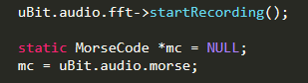
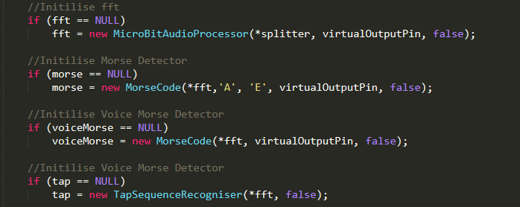
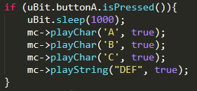
uBit initialised + Auto run on function calls (don’t need to call fft->startRecording)

Slide 24
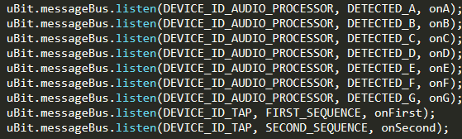
Events

